Slide 1
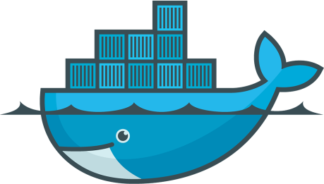

"Containerizing" Angular with Docker

Slide 2
Agenda
Why Containers?
What Are Containers?
Running Angular on a "Real" Server
Building Angular with Containers
Angular and Services
Deploying Between Environments

Slide 3
Why Containers?

Slide 4
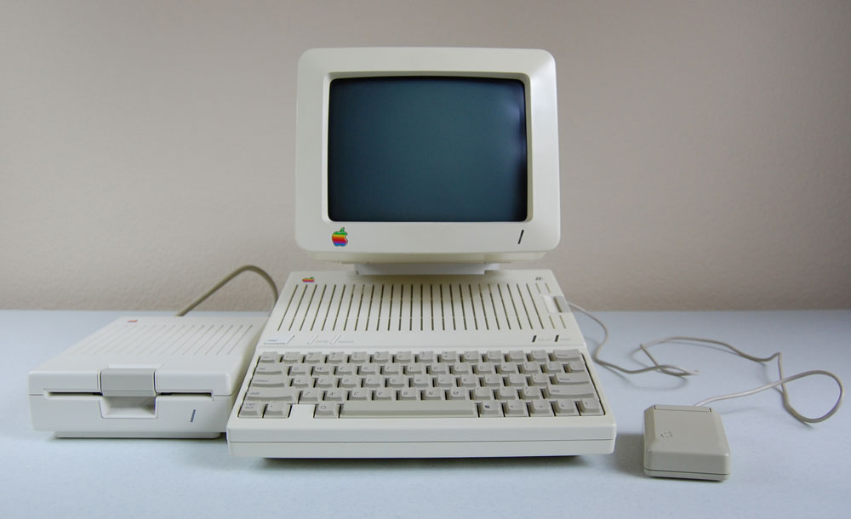

Slide 5
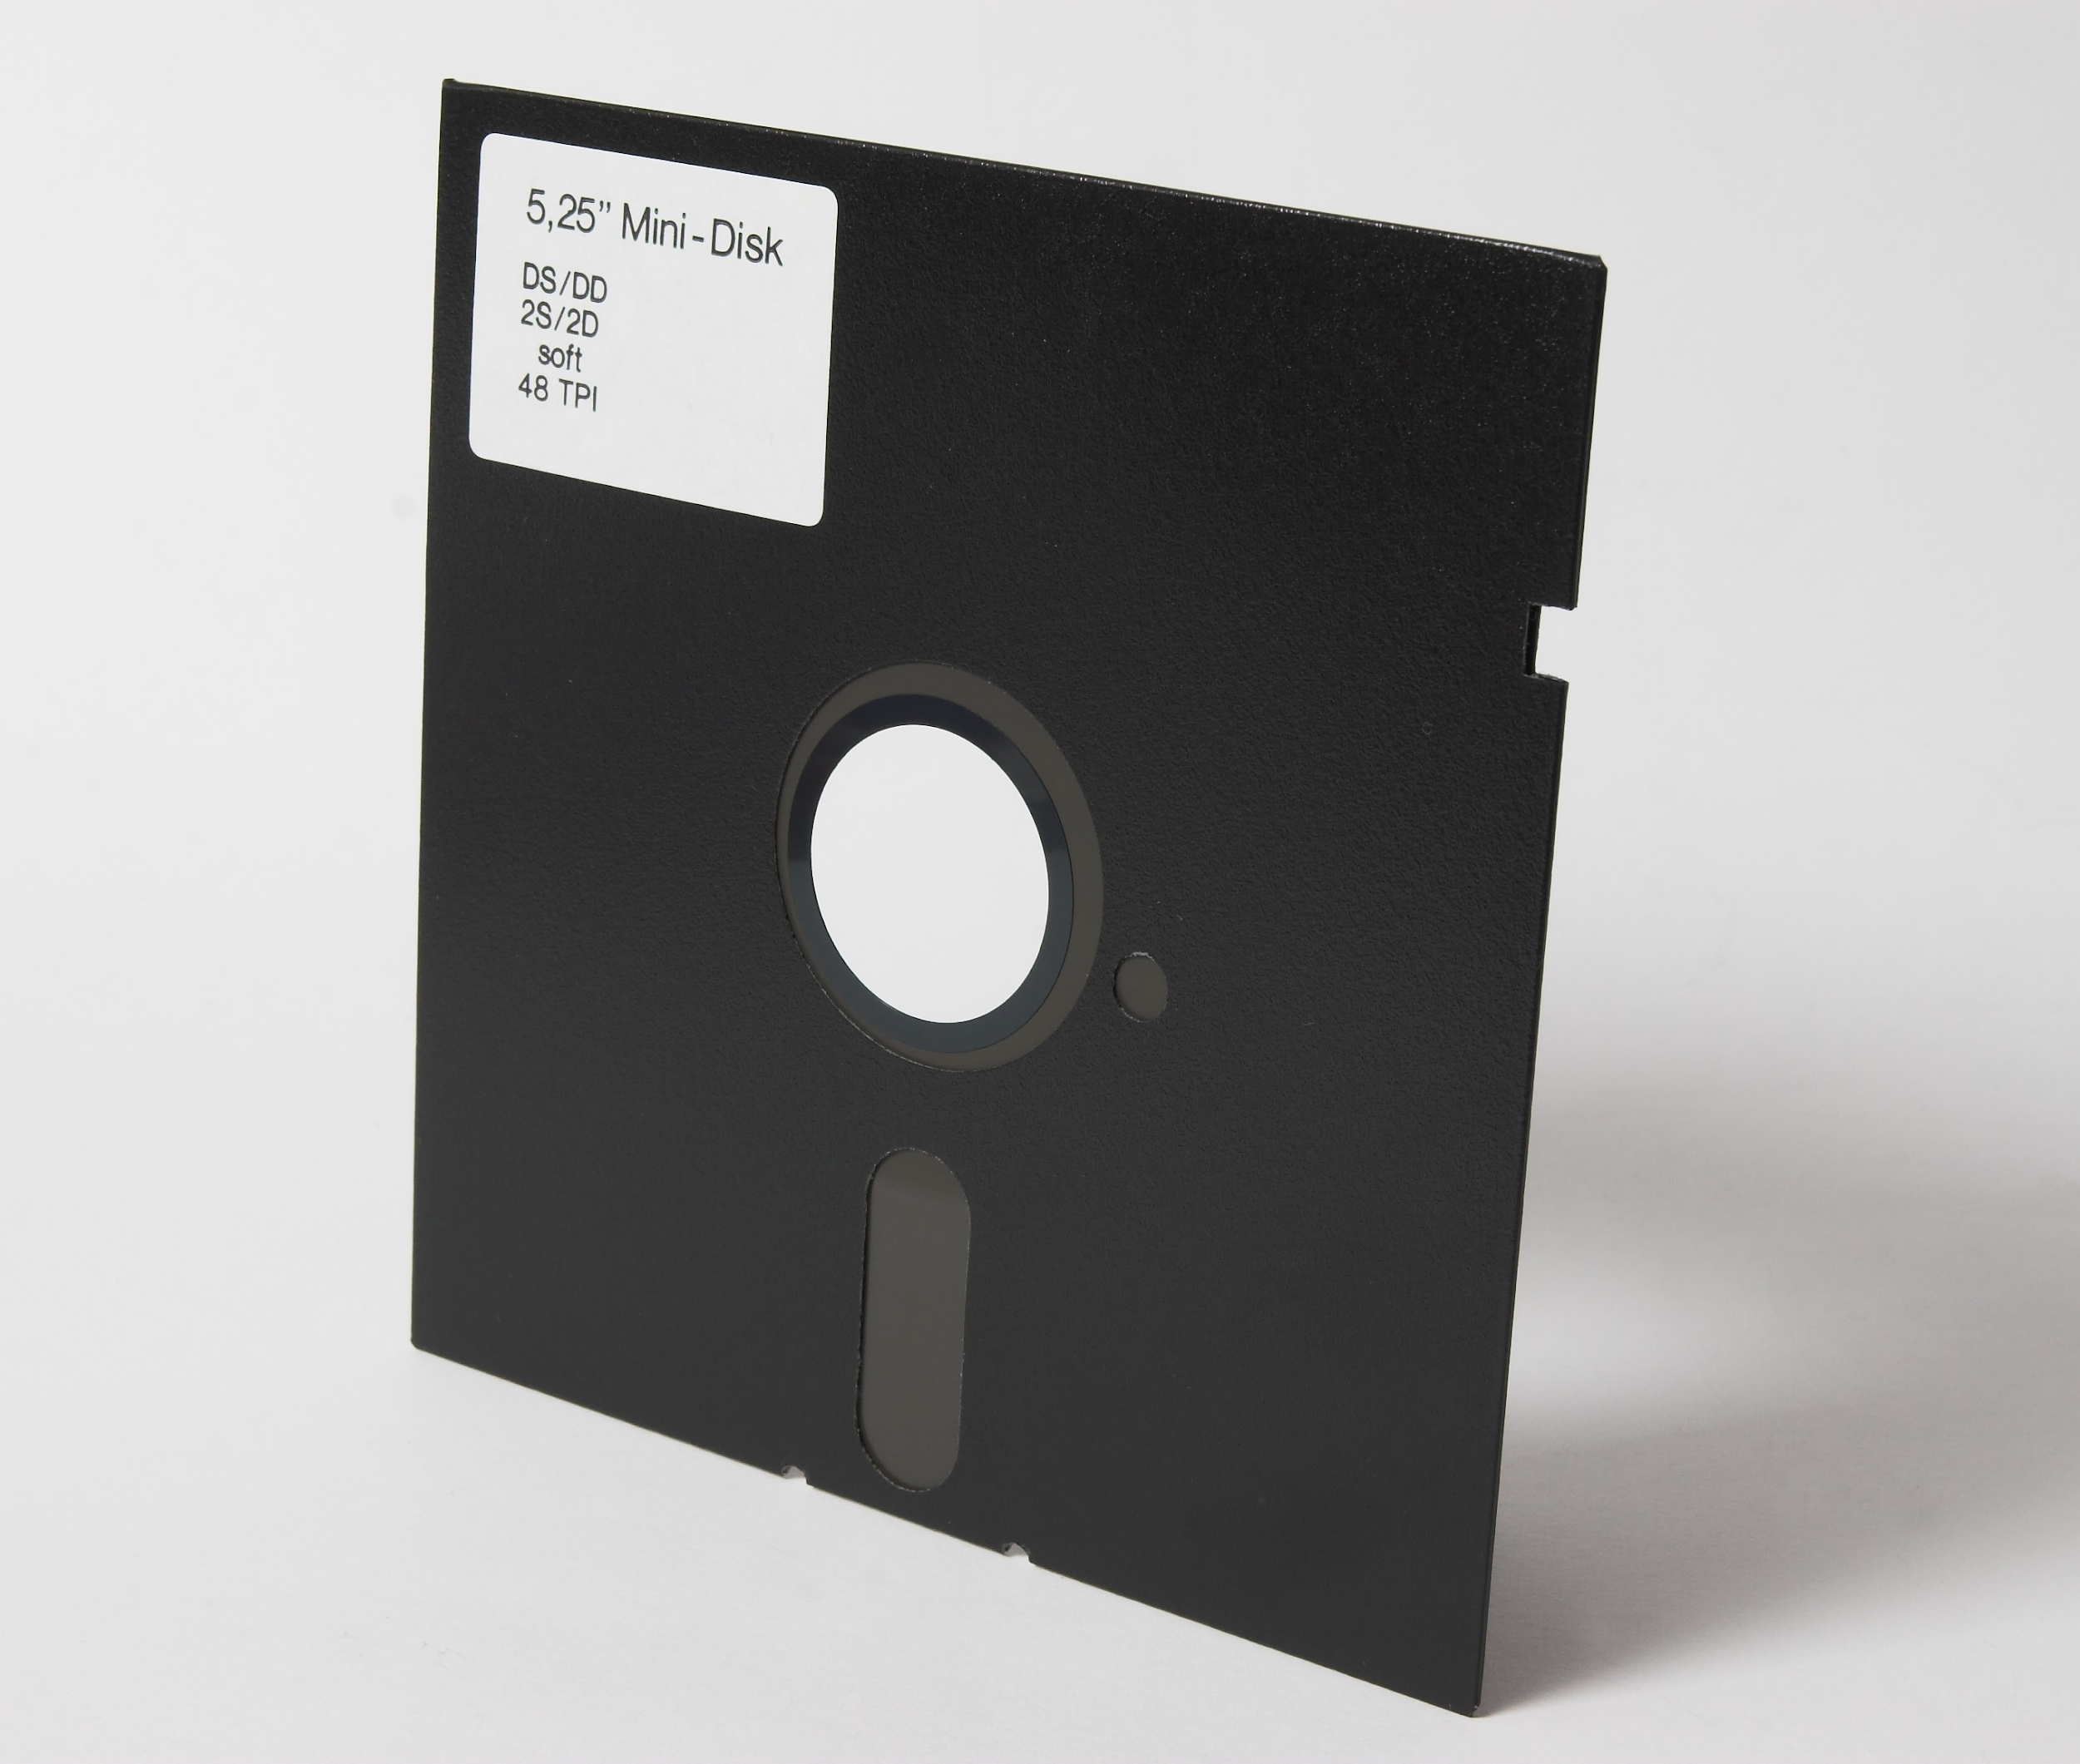

Slide 6
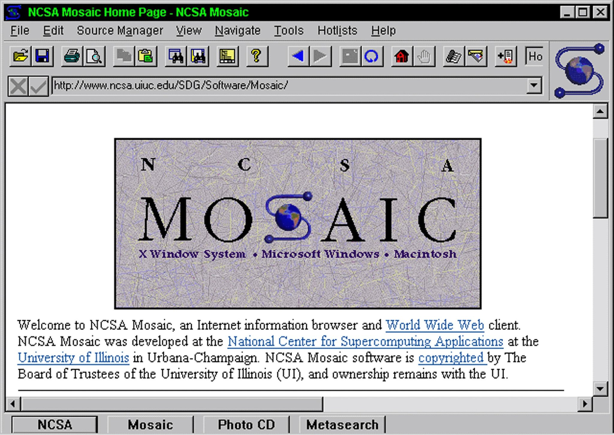

Slide 7
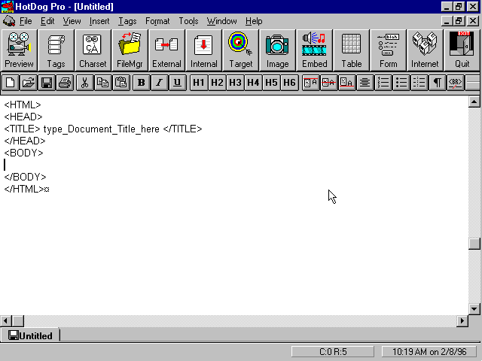

Slide 8
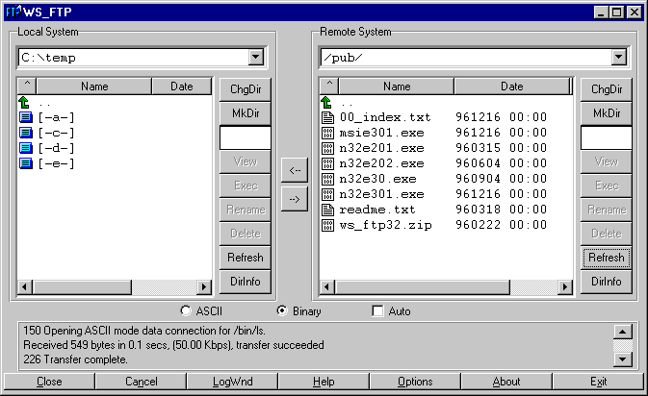

Slide 9

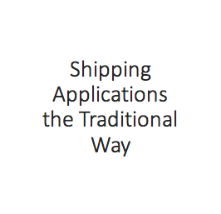

Slide 10
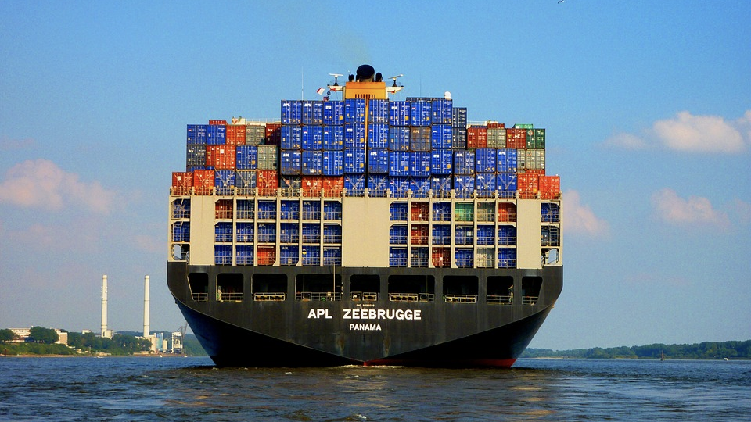
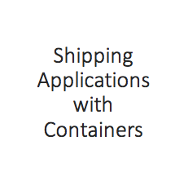
ngular
Service 1
Service 2
Service 3

Slide 11
Simplify building, shipping, running apps
Provides a shipping container system for code
Runs natively on Linux or Windows Server
Runs on Windows or Mac Development machines (with Docker CE)
Supports "images" and "containers"
How can Docker help?

Slide 12
What are Containers?

Slide 13
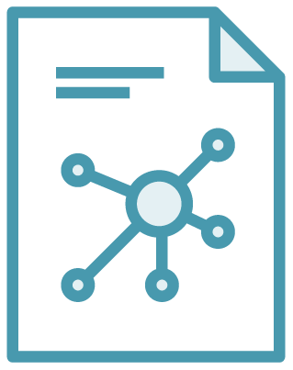

The Role of Images and Containers
Docker Image
Docker Container

Slide 14
Image
A read-only template composed of layered filesystems used to share common files and create Docker container instances.

Slide 15
Container
An isolated and secured shipping container created from an image that can be run, started, stopped, moved and deleted.

Slide 16
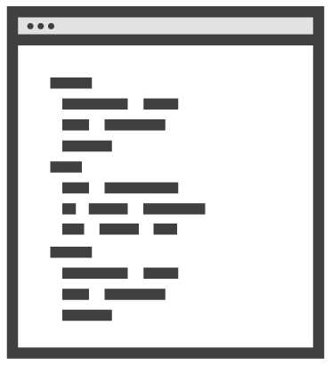

DockerFile and Images
docker build
Dockerfile
Docker Image
Notes:
Think of a Dockerfile as being similar to a code file. You run the code file through a compiler and get a binary. With Dockerfile, you run it through a Docker client build process and get a Docker image.

Slide 17
Steps to Create Service Containers
Install Docker CE for Mac or Windows (Docker Toolbox if on Windows 7)
Create a custom Dockerfile (if needed) or pull image
Run Docker client commands to build images and run containers

Slide 18
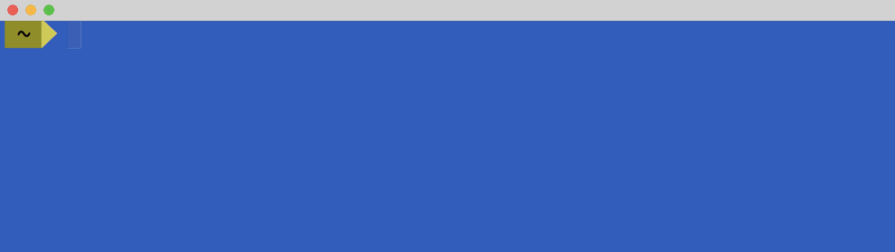
Pulling a Docker Image
docker pull nginx:alpine

Slide 19
Running a Container
docker run -d -p 8080:80 nginx:alpine
External/Internal Port
Image Name

Slide 20
Demo:
Docker in Action
Notes:
docker run --name my-nginx -d -p 8080:80 nginx:alpine
To run a project generated from the Angular CLI in nginx do the following:
Run ng build
cd into the "dist" folder
Run the following command:
docker run -d -p 8080:80 -v $(pwd):/usr/share/nginx/html nginx:alpine
Note: The Angular CLI currently deletes the "dist" folder and recreates it when running ng build so if you run it again the volume defined above won't work correctly. Something I'm hoping they'll change.

Slide 21
Running Angular on a "Real" Server

Slide 22
Running Angular on a "Real" Server
The Angular CLI is great for local development: ng serve -o (note that "server" also works)
How are you running Angular in production?
Are you able to run your staging/production environment on your local machine?

Slide 23
Angular Server Options
nginx
HAProxy
Apache
Node.js
IIS
More...

Slide 24
Steps to Run Angular in a Container
build
run
Dockerfile
Docker Image
Docker Container
Notes:
Think of a Dockerfile as being similar to a code file. You run the code file through a compiler and get a binary. With Dockerfile, you run it through a Docker client build process and get a Docker image.

Slide 25
Running Local Code in a Container
docker run -d -p 8080:80 -v $(pwd)/dist:/usr/share/nginx/html nginx:alpine
Local Directory
Container Directory

Slide 26
nginx Dockerfile Example
FROM nginx:alpine
LABEL author="Dan Wahlin"
COPY ./dist /usr/share/nginx/html
Notes:
A data volume is directory or file that is mounted directly into a container.
https://docs.docker.com/engine/userguide/storagedriver/imagesandcontainers/

Slide 27
Building a Custom Image
docker build -t /ngapp:1.0.0 .
Repository
Image Name
Tag Name

Slide 28
Running a Custom Container
docker run -d -p 8080:80 /ngapp:1.0.0

Slide 29
Demo:
Running Angular in a Server Container
Notes:
docker run --name my-nginx -d -p 8080:80 nginx:alpine
To run a project generated from the Angular CLI in nginx do the following:
Run ng build
cd into the "dist" folder
Run the following command:
docker run -d -p 8080:80 -v $(pwd):/usr/share/nginx/html nginx:alpine
Note: The Angular CLI currently deletes the "dist" folder and recreates it when running ng build so if you run it again the volume defined above won't work correctly. Something I'm hoping they'll change.

Slide 30
Building Angular with Containers

Slide 31
Building Angular with Containers
Containers can be used to build automate Angular builds locally or on a CI/CD server
Multi-stage dockerfiles can be used to build your code and create a final production image

Slide 32
Building Angular with Multi-Stage Dockerfiles
Build
Angular
Copy dist
Dockerfile
Intermediate Node.js Image
Docker Image with Angular
Notes:
Think of a Dockerfile as being similar to a code file. You run the code file through a compiler and get a binary. With Dockerfile, you run it through a Docker client build process and get a Docker image.

Slide 33
Demo:
Building Angular with Containers
Notes:
docker run --name my-nginx -d -p 8080:80 nginx:alpine
To run a project generated from the Angular CLI in nginx do the following:
Run ng build
cd into the "dist" folder
Run the following command:
docker run -d -p 8080:80 -v $(pwd):/usr/share/nginx/html nginx:alpine
Note: The Angular CLI currently deletes the "dist" folder and recreates it when running ng build so if you run it again the volume defined above won't work correctly. Something I'm hoping they'll change.

Slide 34
Angular and Services

Slide 35
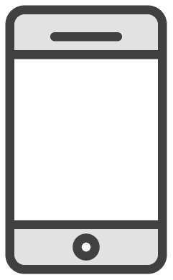
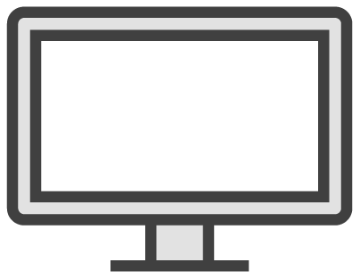
Microservices Architecture
Identity
DB
API
GATEWAY
REST
API
Identity
Service
Mobile APP
Catalogue
DB
REST
API
Catalogue
Service
SPA
WebApp
Ordering
DB
REST
API
Ordering
Service
REST
API
WebApp
MVC
Traditional
WebApp
Basket
DB
REST
API
Basket
Service
Notes:
http://microservices.io/patterns/microservices.html
Animate from left to right. For example, show the "mobile app" circle (fade in), then show "API Gateway", then fade in arrows to Account Services, Inventory, Storefront, the DBs, etc. Then, lastly animate in the "Browser" pointing to "Storefront WebApp".

Slide 36
Microservices Architecture
Brakes
Tires
Car
Wiper Blades
Oil
Notes:
Car does not have to be shipped back to factory go get work done. You can simply update the individual parts likes brakes or tires whenever needed without doing anything to the test of the car.

Slide 37
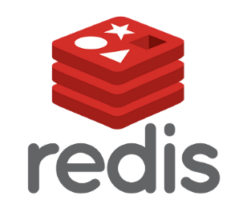

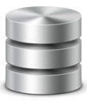
Service
Service
Service
Question: How easy is it to get standard services or microservices going in dev, staging and production?

Slide 38
Service
Service
Service
Orchestrate Services with Docker Compose

Slide 39
The Role of the Docker Compose File
Docker Compose Build
docker-compose.yml (service configuration)
Docker Images (services)
Notes:
Think of a Dockerfile as being similar to a code file. You run the code file through a compiler and get a binary. With Dockerfile, you run it through a Docker client build process and get a Docker image.

Slide 40
docker-compose.yml Example
version: '3.1'
services:
nginx:
build: context: .
dockerfile: nginx.dockerfile
networks: -app-network
postgres: image: postgres networks: - app-network
networks: app-network driver: bridge
Notes:
A data volume is directory or file that is mounted directly into a container.
https://docs.docker.com/engine/userguide/storagedriver/imagesandcontainers/

Slide 41
Running Your Dev Environment
Run docker-compose build
Run docker-compose up
Live long and prosper!

Slide 42
Demo:
Angular and Microservices
Notes:
docker run --name my-nginx -d -p 8080:80 nginx:alpine
To run a project generated from the Angular CLI in nginx do the following:
Run ng build
cd into the "dist" folder
Run the following command:
docker run -d -p 8080:80 -v $(pwd):/usr/share/nginx/html nginx:alpine
Note: The Angular CLI currently deletes the "dist" folder and recreates it when running ng build so if you run it again the volume defined above won't work correctly. Something I'm hoping they'll change.

Slide 43
Deploying Between Environments

Slide 44
Cloud and Containers
Containers can be pushed to an on-premise or cloud repository
Docker Hub
Azure
AWS
Google Cloud

Slide 45
Pushing a Docker Image
docker push /ngapp:1.0.0

Slide 46
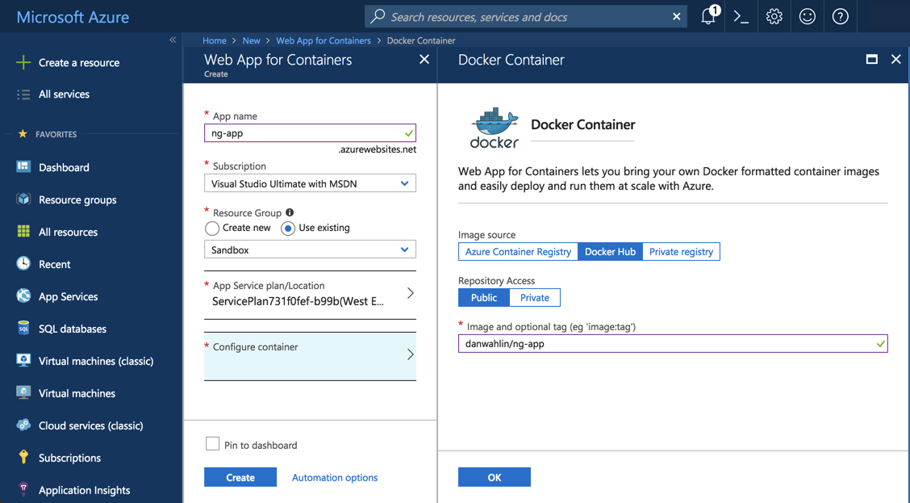
Pushing to the Cloud

Slide 47
Questions?

Slide 48
https://github.com/ /Angular-Core-Concepts
Other Projects:
https://github.com/ /Angular-ASPNET-Core-CustomersService
https://github.com/ /Angular-NodeJS-MongoDB-CustomersService
https://github.com/ /Angular-RESTfulService
https://github.com/ /Angular-Docker-Microservices
https://github.com/ /CodeWithDanDockerServices
A Few Docker Projects

Slide 49
Docker for Web Developers
https://www.pluralsight.com/courses/docker-web-development
Integrating Angular with Node.js RESTful Services
https://www.pluralsight.com/courses/angular-nodejs-restful-services
Integrating Angular with ASP.NET Core RESTful Services
https://www.pluralsight.com/courses/angular-aspnetcore-restful-services

Slide 50
Bonus Material

Slide 51
Key Image Commands docker pull [imageName]
docker images
docker rmi [imageID]
Key Container Commands docker run -p externalPort:internalPort [imageName] docker ps -a
docker stop [containerID]
docker rm [containerID]

Slide 52
Special type of directory in a container typically referred to as a "data volume"
Can be shared and reused among containers
Updates to an image won't affect a data volume
Data volumes are persisted even after the container is deleted
Docker Volumes

Slide 53

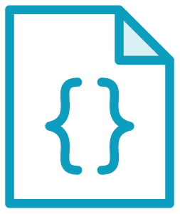
Volume Overview
Docker Host
/mnt/…
Volume
/var/www
Notes:
A data volume is directory or file that is mounted directly into a container.
https://docs.docker.com/engine/userguide/storagedriver/imagesandcontainers/

Slide 54
Customizing Volumes
Docker Host
/src
Volume
/var/www
Notes:
A data volume is directory or file that is mounted directly into a container.
https://docs.docker.com/engine/userguide/storagedriver/imagesandcontainers/

Slide 55
Images docker build -t [imageName] .
docker push [imageName]

